Slide 1

World Technology CO, LTD
Tel: 0827-22-5740 0900-1700 M-F
Fax: 0827-22-5750
Cell: 090 8245-6860
Logistics
Date:
Time:
Location:
World Tech Contact: David
World Tech Contact Tel: 09017280896
Total Weight: 536 KG

Slide 2
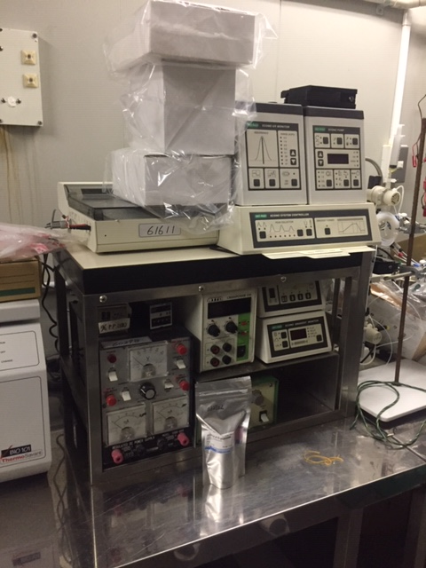
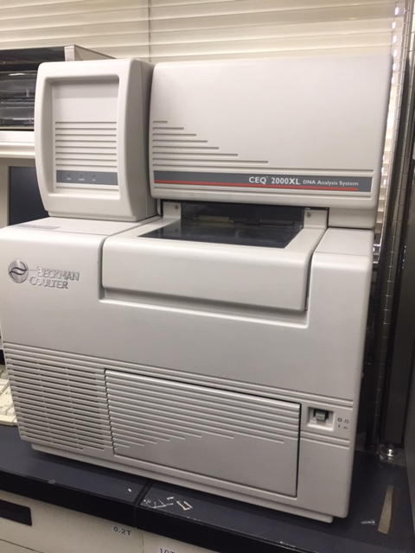
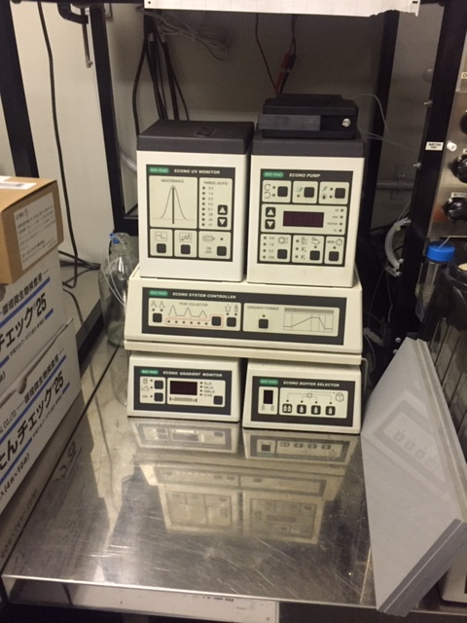
A
Height: 47 cm
Width: 52 cm
Length:47 cm
Weight: 30 kg
Pieces: 6
Remarks:
Height: 94 cm
Width: 61 cm
Length: 61 cm
Weight: 70.5 kg
Pieces:
Remarks: NEED COMPUTER
Height: 47 cm
Width: 48 cm
Length: 40 cm
Weight:10 kg
Pieces:5
Remarks:

Slide 3
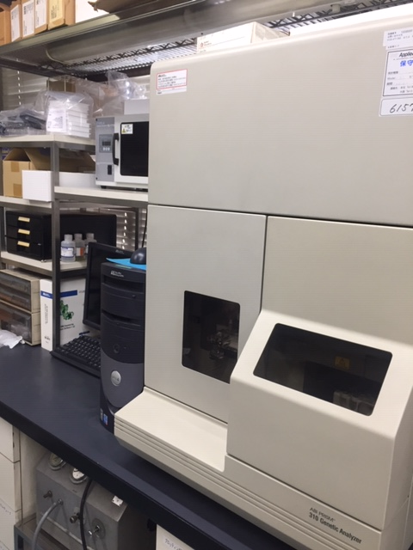
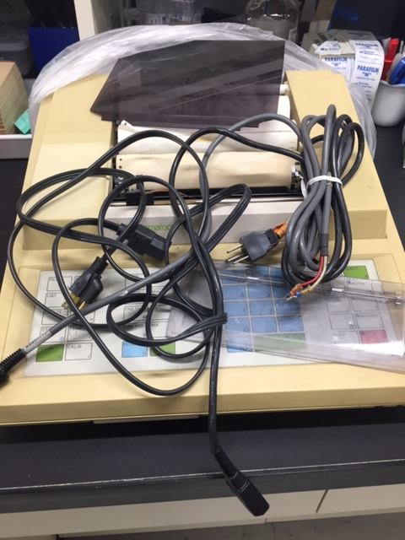
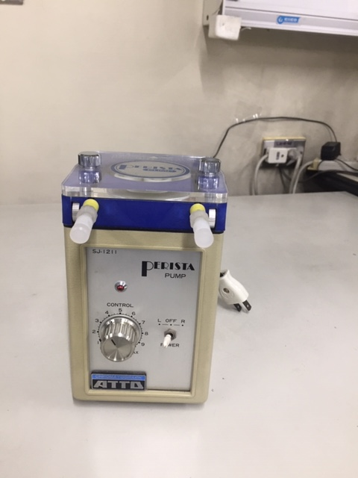
B
Height: 86.36 cm
Width: 60.96 cm
Length: 55.88 cm
Weight: 94.5 kg
Pieces:3.
Remarks: NEED COMPUTER
Height: 12 cm
Width: 40 cm
Length:50 cm
Weight: 2 kg
Pieces:1
Remarks: Cord
Height:20 cm
Width: 15 cm
Length: 15 cm
Weight: 2 kg
Pieces: 1
Remarks: None.

Slide 4
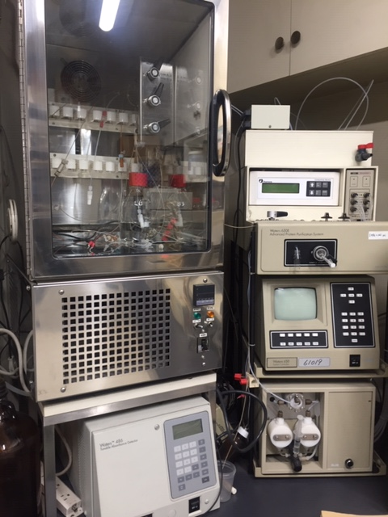
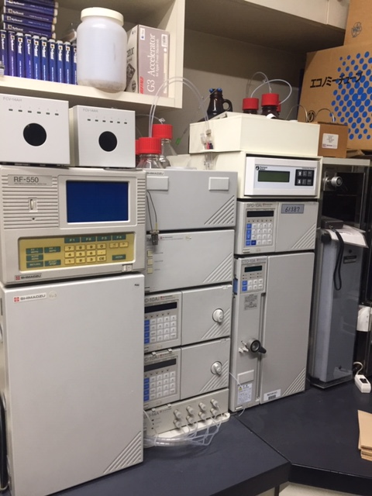
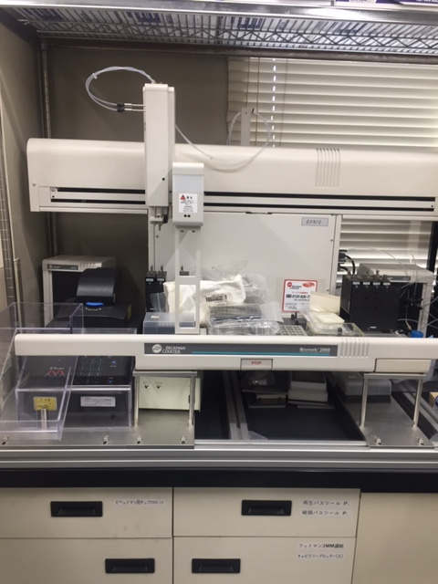
Height:100cm
Width: 70 cm
Length:60 cm
Weight:50 kg
Pieces: 6
Remarks: None
Height:89 cm
Width:100 cm
Length:57 cm
Weight: 60 kg
Pieces: 11
Remarks:None
Height:80 cm
Width: 100 cm
Length: 100 cm
Weight:20 kg
Pieces:2
Remarks:None

Slide 5
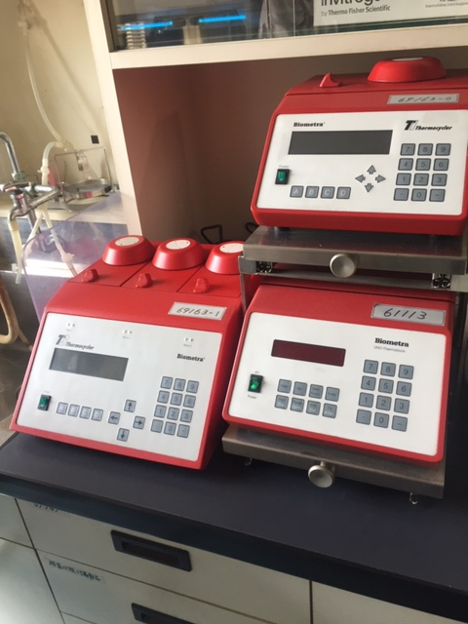
Height: 38 cn
Width: 40 cm
Length: 24 cm
Weight: 15 kg
Pieces: 2 or 3
Remarks:

